Slide 1
Microsoft & .NET
In South Africa Still Relevant?
AccsoCon 2026 | Neil Thompson & Zachary Jackson

Slide 2
What we are covering today?
Lay of the land
Digital sovereignty, .NET in South Africa, and some of the work Accso deliver using .NET
There's More Than APIs Blazor in the real world, Rocket Poker, and why the ecosystem matters more than ever in the age of AI coding agents
AI in Your Solutions
How .NET makes AI integration practical for document processing, intelligent workflows, and real client delivery
The Community Proving It
CPTMSDUG, the numbers, and how Accso is right at the heart of it
About 45 minutes. We will leave time for questions at the end.

Slide 3
Lay of the land
Zachary

Slide 4
Digital sovereignty
Across Europe, the conversation around technology choices is evolving.
Questions around digital sovereignty, data residency, and dependency on U.S. hyperscalers are real and worth taking seriously.
Germany in particular has been thoughtful about evaluating these tradeoffs, and that is a sign of a mature engineering culture, not a rejection of good technology.
Accso's teams navigate this every day. The considerations are legitimate.
This talk is not about that debate. It is about what is happening in South Africa and why it matters for all of us at Accso.
Notes:
Keep this warm and collegial. You are talking to colleagues, not critics.
Our colleagues think carefully about technology choices and that is something to respect, not argue with.
The sovereignty conversation is real and important.’
But South Africa sits in a different context.
And we think that context is worth sharing because we are one company, and what is thriving in Cape Town is relevant to everyone here.

Slide 5
Some History
🏢 Microsoft opened its first African data centres in Johannesburg & Cape Town in 2019, a long-term commitment to the continent
☁️ Azure is the #1 or #2 cloud provider in SA enterprise
🏦 JSE, FNB, Standard Bank, Nedbank — running on Microsoft stacks
🏛️ Government digitisation — largely built on Microsoft platforms
💼 .NET — among the most in-demand developer skills in the SA job market
📊 C# — top 5 most-used languages globally (Stack Overflow 2025)
Notes:
Microsoft did not just sell licences to South Africa.
They invested in infrastructure, training, and communities.
That investment compounds over 30 years.’
The 2019 data centre announcement mattered enormously.
It meant SA enterprises could keep data on African soil,
which matters for banking and healthcare compliance.’
C# in the top 5 globally, year after year.
This is not a language kept alive by legacy systems.
It is actively chosen by developers building new things.'

Slide 6
Some of our current work using .NET/C#
The SA and Germany teams are part of the same company, and the .NET work we do in Cape Town is directly connected to clients our colleagues know well.
ZDF — one of Germany's oldest public broadcasters. Built on .NET.
BAFA — German Federal Office for Economic Affairs. Production .NET.
DSO — long-standing Accso project. Same stack.
Accso is a Microsoft Gold Partner — certified expertise, demonstrated delivery, formal relationship with Microsoft.

Slide 7
There’s More Than APIs
Neil

Slide 8
What is Blazor?
Blazor is Microsoft's framework for building interactive web UIs in C#, not JavaScript.
Instead of React components in TypeScript, you write Blazor components in C# and Razor, a simple templating syntax that mixes HTML with C# logic.
Those components run either on the server or directly in the browser via WebAssembly.
The result: a modern web application where the entire codebase, front end and back end, is written in one language

Slide 9
Blazor Rendering Modes
Mode | How it works | Best for
Blazor Server | UI runs on server, updates via SignalR WebSocket | Internal apps, fast networks
Blazor WebAssembly | Runs entirely in browser via WASM | Offline-capable apps
Blazor SSR | Server-side rendered HTML on first request | SEO-critical pages, fast first load
Auto | SSR on first load, switches to WASM once cached | Best of both worlds
The Auto mode is genuinely clever. The user gets a fast first load, then full client-side interactivity once the bundle is cached. They never notice the transition.

Slide 10
When do we use it?
If you have .NET people in your team, in SA or in Germany, Blazor is a genuinely solid option for the right projects.
The team already knows C# — zero context switching, immediate productivity
You want one language across the full stack
Enterprise internal tools, dashboards, admin portals
AI-generated code that needs a stable, auditable ecosystem
Projects tightly integrated with Azure or Microsoft identity
If the team has deep JavaScript expertise, do not force it. Something like React still wins on raw component ecosystem size. This is about pragmatic choices, not tribal ones The question is not "is Blazor better than other frameworks?" it should be what fits better for the project and the team?

Slide 11
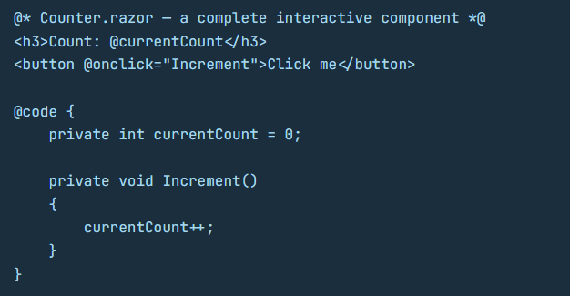
What does it look like?
A fully interactive component — click, state update, re-render — in 10 lines.
No JavaScript. No npm install. No webpack config. Just C#.

Slide 12
Built by Accso — Rocket Poker 🚀
The Accso .NET Community did not just talk about Blazor. They built something real with it.
Rocket Poker is an internal planning poker tool for agile estimation sessions, written entirely in Blazor.
Real-time updates across participants. Interactive UI. No JavaScript framework involved.
Just .NET developers building a web application in the language they already knew and shipping it
Not a tutorial. Not a proof of concept. A tool Accso developers actually use.

Slide 13
AI in Your Solutions
Zachary & Neil

Slide 14
AI Is No Longer Optional in Many Projects
More and more, clients are coming to us with AI as a core requirement, not a nice-to-have.
Processing applications. Analysing documents. Extracting structured data from unstructured inputs. Routing, classifying, summarising at scale.
These are not research projects.
They are production features that need to be built, maintained, and trusted.
The question our teams face is: how do we add AI capability to a .NET solution without introducing a whole new stack?
The .NET ecosystem has already solved this, and it fits naturally into the patterns your team already knows.

Slide 15
The Model Doesn't Matter
The model most of us reach for: Claude by Anthropic — excellent for reasoning, document analysis, and long-context tasks.
But the most important thing about the .NET AI ecosystem is that it is completely model-agnostic.
Claude, GPT-4, Mistral, or a local model running on your own machine via Ollama — you write your application code once and swap the model in one line. Your architecture does not change. Your tests do not change. Your deployment does not change.
This matters enormously when you are integrating AI into a production solution. You are not locked in, and you are not rebuilding when requirements change..

Slide 16
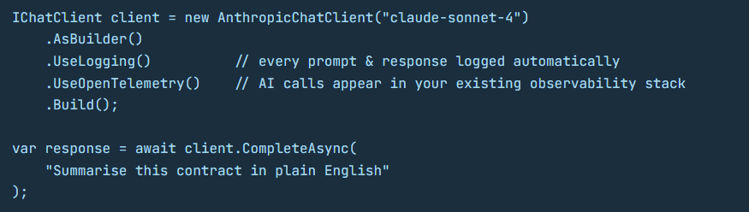
Microsoft.Extensions.AI Think HttpClient for LLMs
To switch models, change one line. App code, tests, and deployment stay the same.
These are not AI-specific features. They are .NET features that now apply to AI.
Notes:
Out of the box:
- logging middleware
- OpenTelemetry
- retry and rate limiting via Polly
- semantic caching
The same patterns .NET developers already know, now applied to AI calls.
That is the power of the abstraction.

Slide 17
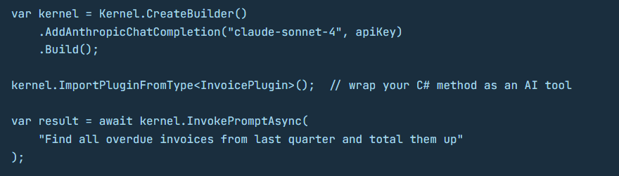
Semantic Kernel Your App Calls the AI. The AI Calls Your App.
The AI reasoned about the tools available and decided on its own to call your code.
You did not tell it to. That is an agent.
Notes:
'What just happened there?
The AI decided on its own that it needed to call your InvoicePlugin.
It reasoned about the tools available and used the right one.
You can wrap any existing C# method as a tool the AI can call.
That is it. Your existing business logic becomes AI-callable with one line.'

Slide 18
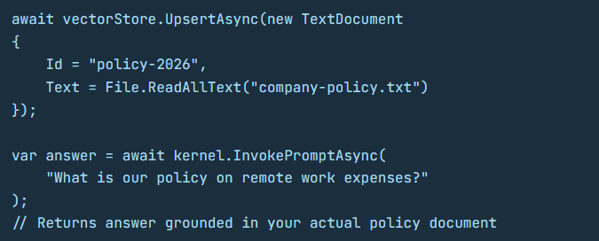
RAG Your Documents. Your Answers.
This pattern is replacing internal wikis, policy docs, and FAQ pages across SA enterprises — not because it is trendy, but because it works.
Notes:
RAG — Retrieval Augmented Generation.
The technique behind most enterprise AI tools that actually work in production
.NET developers can build this without learning a new language or a new paradigm.
It fits into the patterns they already know.

Slide 19
RAG Your Documents. Your Answers.
This pattern is replacing internal wikis, policy docs, and FAQ pages across SA enterprises — not because it is trendy, but because it works.
Notes:
RAG — Retrieval Augmented Generation.
The technique behind most enterprise AI tools that actually work in production
.NET developers can build this without learning a new language or a new paradigm.
It fits into the patterns they already know.

Slide 20
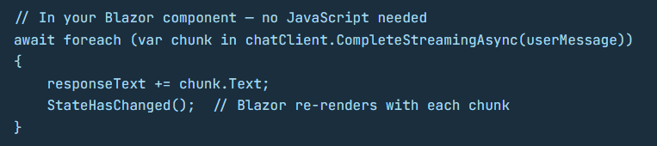
Streaming AI in a Blazor App
The same typing effect you see in Claude or ChatGPT.
No JavaScript. No separate frontend team. One language. One codebase. One deployment.
Notes:
Blazor for the UI, SignalR for the real-time WebSocket,
Microsoft.Extensions.AI for the LLM call.
Genuinely powerful and underappreciated.
Most people have not tried this combination yet.
The ones who have tend not to go back.

Slide 21
The Community In SA
Neil

Slide 22
Neil Still needs to add the details here

Slide 23
AI is changing how software gets built.
Digital sovereignty is changing where it gets built.
Both of those things raise real questions — and .NET has real answers to both.
South Africa remains a strong home for .NET talent, delivery, and community,
and that benefits the whole of Accso

Slide 24
Questions?

